Slide 1

Investment management for individual needs using robo-advisors
Your intelligence made you money, let our intelligence grow it.

Slide 2

Need for this approach
One size doesn’t fit all.
Personal financial advisors don’t find it worthy to manage middle class finance.
Current research includes only individual models work.
No research suggests investment strategies for individual needs.
Financial models are a closely guarded secret.

Slide 3
Tipping our hats to those who came before us….
Lu, W., Li, J., Wang, J., & Qin, L. (2021). A CNN-BiLSTM-AM method for stock price prediction. Neural Computing and Applications, 33, 4741-4753.
Virlics, A. (2013). Investment decision making and risk. Procedia Economics and Finance, 6, 169-177.
Ma, Y., Han, R., & Wang, W. (2021). Portfolio optimization with return prediction using deep learning and machine learning. Expert Systems with Applications, 165, 113973.

Slide 4
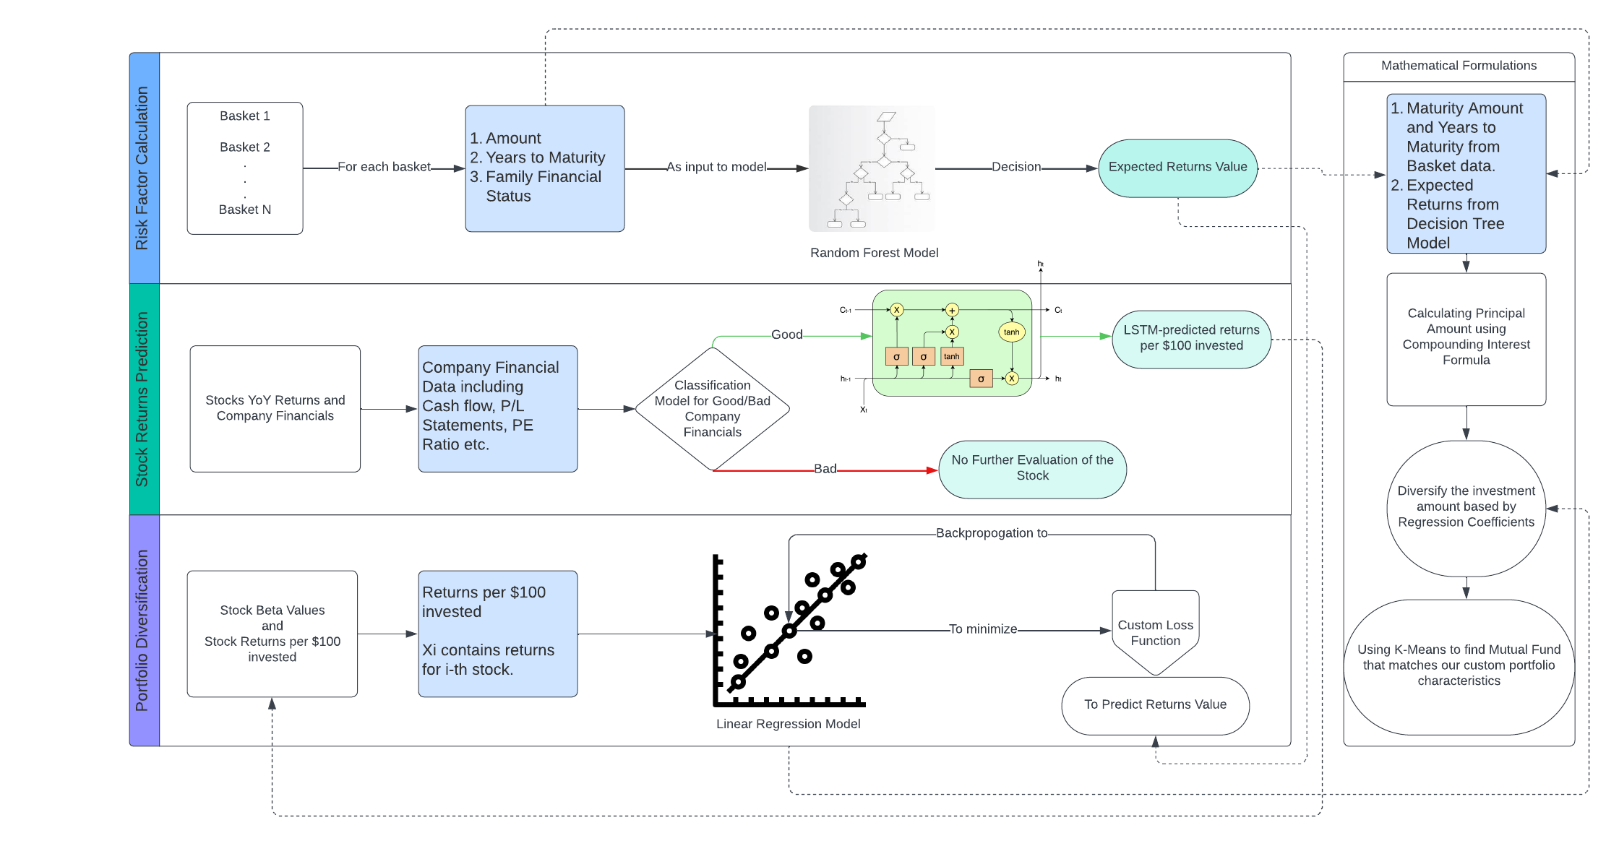
Flow chart
Using Euclidean distance to find the mutual fund with similar characteristics

Slide 5
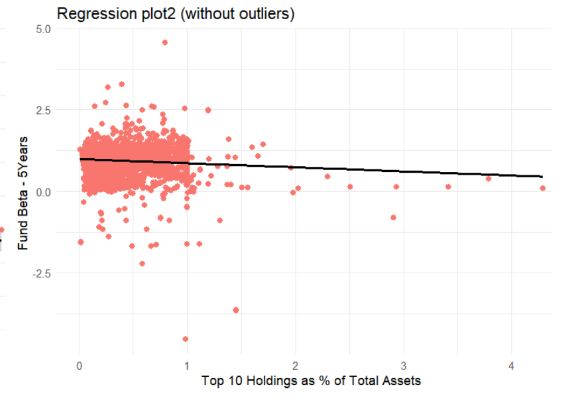
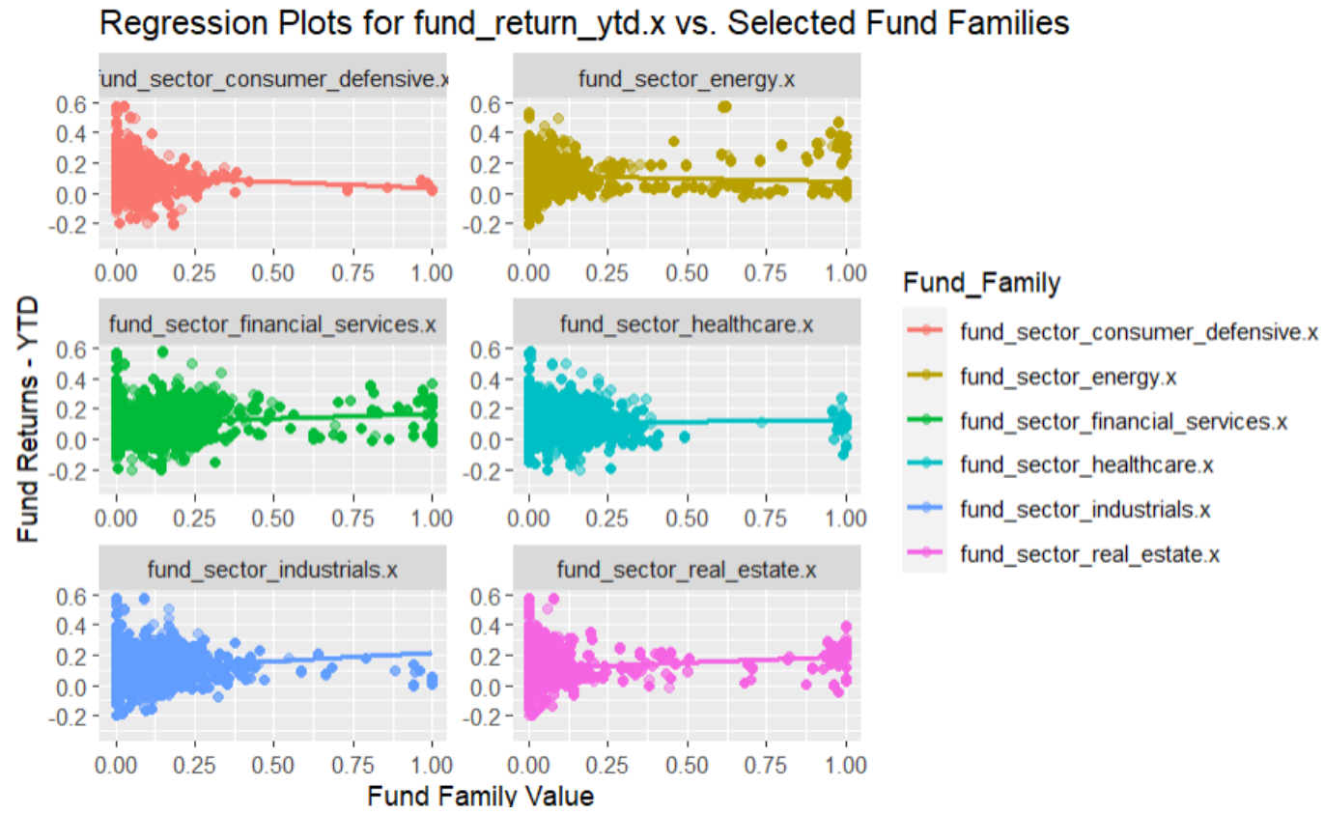
Visualizations

Slide 6
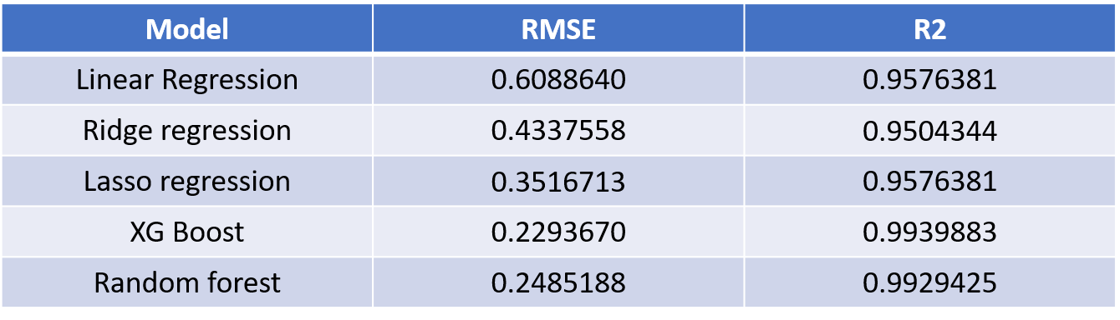
Customer XYZ | Amount Required | Years of Maturity
Basket 1 | $183,644.19 | 27
Basket 2 | $70,183.04 | 13
Basket 3 | $27000 | 7
Expected Returns
(Regression)
XGBoost
Risk Associated
(Ordinal Classification)
Random Forest
Model | Accuracy | Precision | Recall
Decision Tree | 0.9287 | 0.913 | 0.933
Random Forest | 0.9564 | 0.961 | 0.958

Slide 7
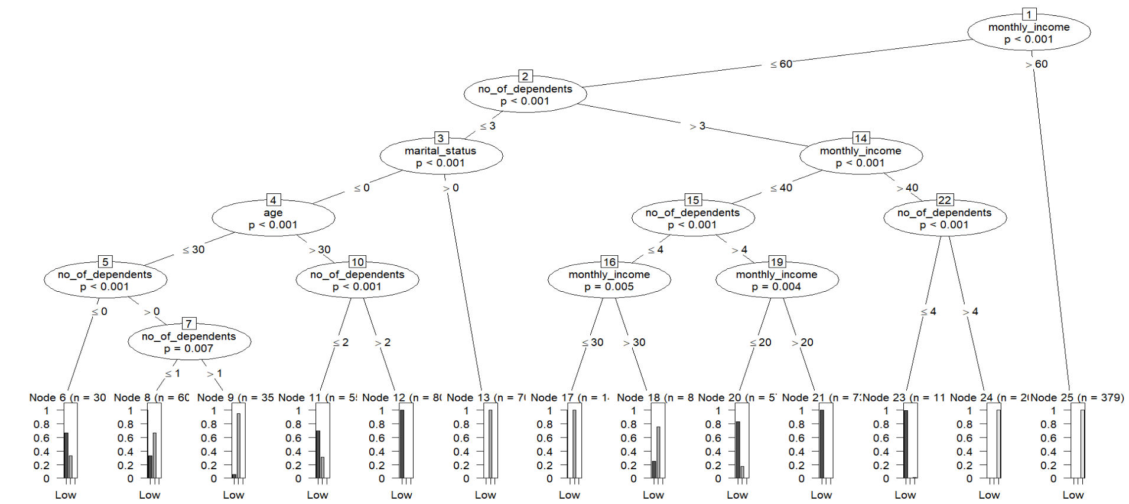
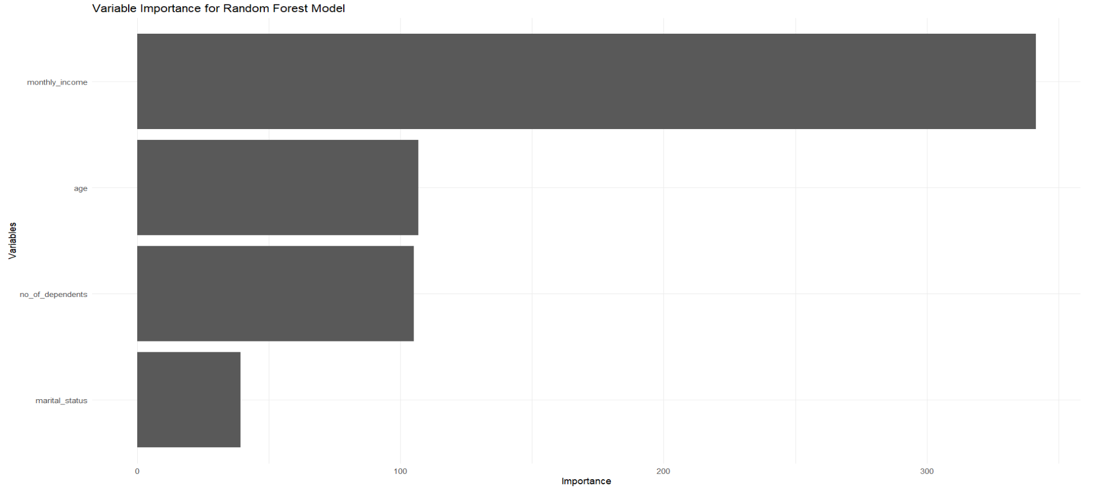
Variable importance
Monthly Income
Age
No. of Dep.
High
Medium
Low
Low
Medium
Low
Medium
Low
High
Medium
Low
Low
Low
Medium

Slide 8
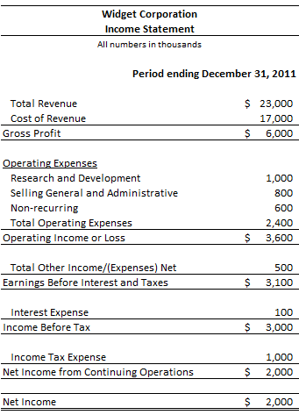
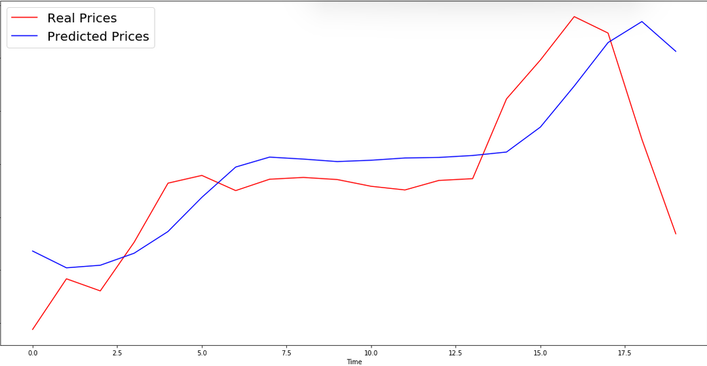
Model | Accuracy | False Positive Rate
CART | 0.7642276 | 0.2159412
Logistic Regression | 0.7085020 | 0.3550362
kNN | 0.7530364 | 0.3750780
XGBoost | 0.9555 | 0.028
Time-step | Loss
1 | 0.05
2 | 0.21
3 | 0.33
4 | 1.76
5 | 8.23
6 | 16.89
7 | 27.36
8 | 57.01

Slide 9
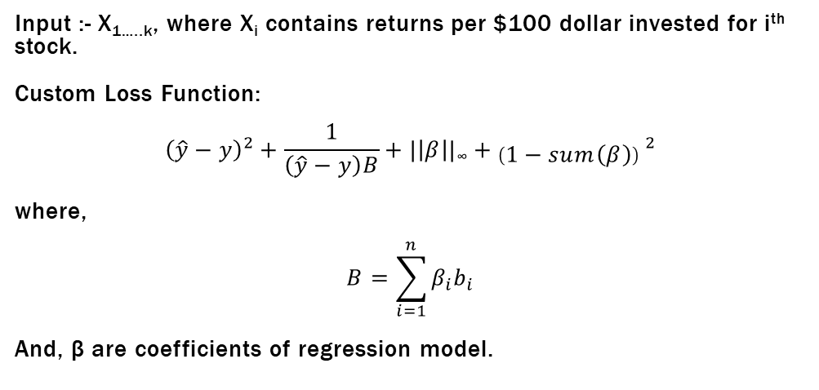
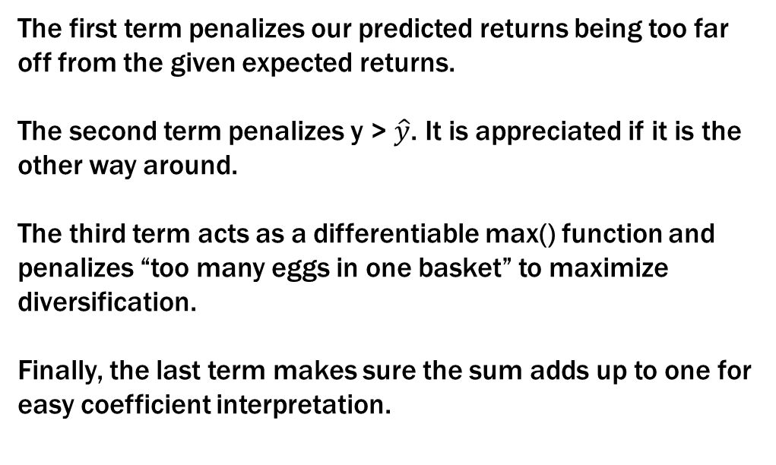
The first term penalizes our predicted returns being too far off from the given expected returns.
The second term penalizes y > $\hat{y}$. It is appreciated if it is the other way around.
The third term acts as a differentiable max() function and penalizes “too many eggs in one basket” to maximize diversification.
Finally, the last term makes sure the sum adds up to one for easy coefficient interpretation.
Input :- X_{1…..k}, where X_{i} contains returns per $100 dollar invested for i^{th} stock.
Custom Loss Function:
$${\left(\hat{y}−y\right)}^{2}+\frac{1}{\left(\hat{y}−y\right)B}+|\left|β\right||\text{∞}+\left(1−sum\left(β\right)\right) ^{2}$$
where,
$$B=\sum_{i=1}^{n}{β_{i}b_{i}}$$
And, β are coefficients of regression model.

Slide 10
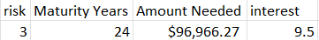
P = A / (1 + r/n)^{nt}
Now that we know that the sum of coefficients add up to 1, the coefficient associated with every stock is the proportion of principal amount to be invested in that stock.
$11,228.95
0.2 0.5 0.15 0.15
Using Euclidean distance to find the mutual fund with similar characteristics
$2,245
$5,614
$1,684
$1,684
AAPL
MSFT
GOOG
AMZN

Slide 11




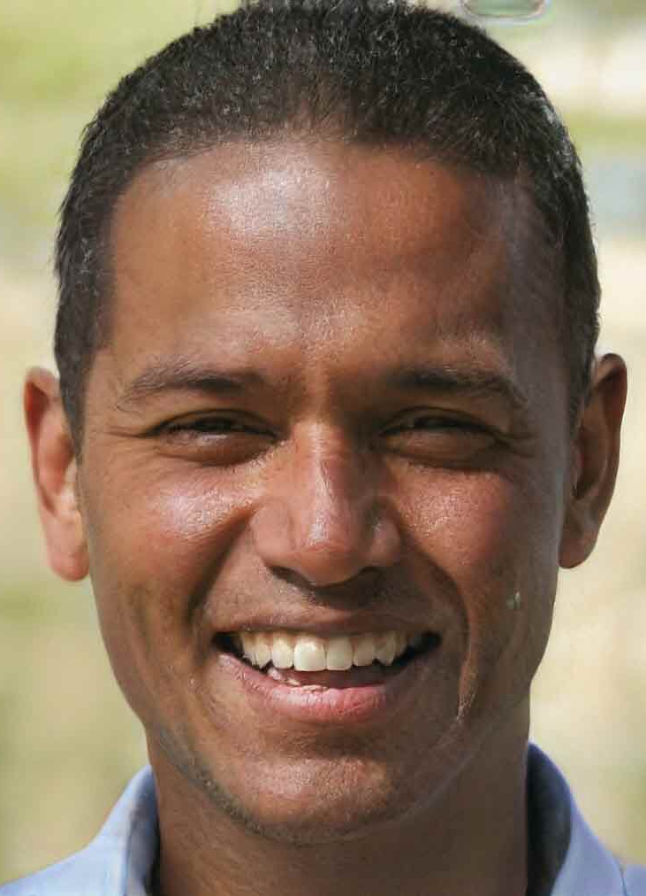
Your financial advisors’ financial advisor
Algorithms : not visible; likes to work behind the scenes.
CEO, CFO, would take up any role with enough training.
Regression expert
Decision Tree Analyst
LSTM Specialist

Slide 12

Questions?
Because no model is completely reliable until it is tested.

